Slide 1
Number Systems and Codes
CSE 260 : Digital Logic Design

Slide 2
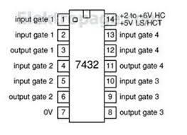
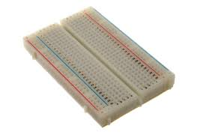
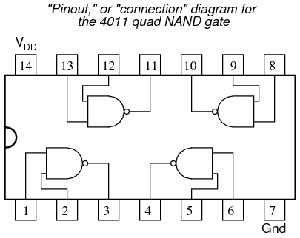
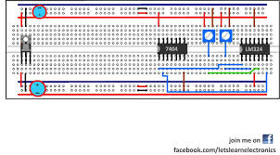
Getting ready for Lab
DSCH2
Bread board
IC

Slide 3
Binary Coded Decimal (BCD)
Decimal numbers are more natural to humans. Binary numbers are natural to computers. Quite expensive to convert between the two.
If little calculation is involved, we can use some coding schemes for decimal numbers.
One such scheme is BCD, also known as the 8421 code.
Represent each decimal digit as a 4-bit binary code.

Slide 4
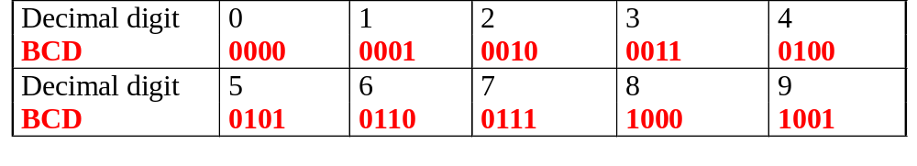
Binary Coded Decimal (BCD)
Some codes are unused, eg: (1010)_{BCD}, (1011) _{BCD}, …, (1111) _{BCD}. These codes are considered as errors.
Easy to convert, but arithmetic operations are more complicated.
Suitable for interfaces such as keypad inputs and digital readouts.

Slide 5
Binary Coded Decimal (BCD)
Examples:
(234)₁₀ = (0010 0011 0100)_{BCD}
(7093)₁₀ = (0111 0000 1001 0011)_{BCD}
(1000 0110)_{BCD} = (86)₁₀
(1001 0100 0111 0010)_{BCD} = (9472)₁₀
Notes: BCD is not equivalent to binary.
Example: (234)₁₀ = (11101010)₂

Slide 6
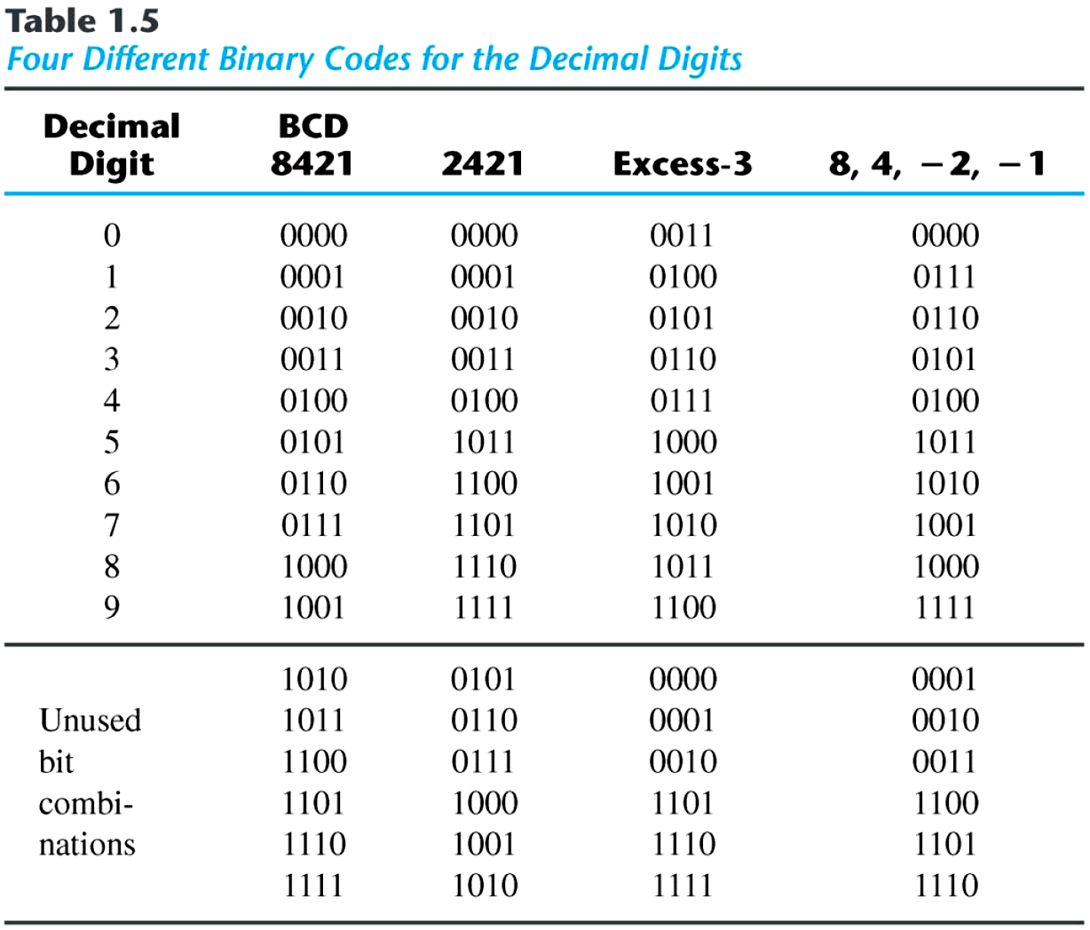
Binary Codes
■ Other Decimal Codes

Slide 7
Negative Numbers Representation
There are three common ways of representing signed numbers (positive and negative numbers) for binary numbers:
  Sign-and-Magnitude
  1s Complement
  2s Complement

Slide 8
Sign-and-Magnitude
Negative numbers are usually written by writing a minus sign in front.
  Example:
  - (12)₁₀ , - (1100)₂
In computer memory of fixed width, this sign is usually represented by a bit:
  0 for +
  1 for -

Slide 9
Sign-and-Magnitude
Example: an 8-bit number can have 1-bit sign and 7-bits magnitude.
sign
magnitude

Slide 10
Signed magnitude representation
Examples:
1101₂ = 13₁₀ (a 4-bit unsigned number)
0 1101 = +13₁₀ (a positive number in 5-bit signed magnitude)
1 1101 = -13₁₀ (a negative number in 5-bit signed magnitude)
0100₂ = 4₁₀ (a 4-bit unsigned number)
0 0100 = +4₁₀ (a positive number in 5-bit signed magnitude)
1 0100 = -4₁₀ (a negative number in 5-bit signed magnitude)
Subtraction (lvk)

Slide 11
Sign-and-Magnitude
Largest Positive Number: 0 1111111 +(127)₁₀
Largest Negative Number: 1 1111111 -(127)₁₀
Zeroes: 0 0000000 +(0)₁₀
1 0000000 -(0)₁₀
Range: -(127)₁₀ to +(127)₁₀
Signed numbers needed for negative numbers.
Representation: Sign-and-magnitude.

Slide 12
1s Complement
Given a number x which can be expressed as an n-bit binary number (i.e. integer part has n digits and fraction has m digit), its negative value can be obtained in 1s-complement representation using:
+7 0111
+6 0110
+5 0101
+4 0100
+3 0011
+2 0010
+1 0001
+0 0000
-7 1000
-6 1001
-5 1010
-4 1011
-3 1100
-2 1101
-1 1110
-0 1111

Slide 13
1’s complement
Approach 1
Approach 2
x_{base} =>base^{n} – base^{m}– x
Example: With an 8-bit number 00001100, its negative value, expressed in 1s complement, is obtained as follows
-(00001100)₂ = - (12)₁₀
=> (2⁸ - 2⁰ - 12)₁₀
=> (2⁸ - 1 - 12)₁₀
= (243)₁₀
= (11110011)_{1s}
-(00001100)₂
_{inverse}
(11110011)₂

Slide 14
1s Complement
Essential technique: invert all the bits.
Examples: 1s complement of 00000001 = (11111110)_{1s}
1s complement of 01111111 = (10000000)_{1s}
Largest Positive Number: 0 1111111 +(127)₁₀
Largest Negative Number: 1 0000000 -(127)₁₀
Zeroes: 0 0000000
1 1111111
Range: -(127)₁₀ to +(127)₁₀=-(2^{n-1} -1) to + (2^{n-1} -1)
The most significant bit still represents the sign:
0 = +ve; 1 = -ve.
Note: Range for n bit no. is –(2^(n-1)-1) to (2^(n-1)-1)

Slide 15
1s Complement
Examples (assuming 8-bit binary numbers):
(14)₁₀ = (00001110)₂ = (00001110)_{1s}
-(14)₁₀ = -(00001110)₂ = (11110001)_{1s}
-(80)₁₀ = -( ? )₂ = ( ? )_{1s}

Slide 16
Other (base-1) complements
Formula: r^{n}-r^{-m}-N
9’s Complement
Example:
  (52520)₁₀ is = 10⁵-1-52520
  =99999-52520
  =47479
  (25.639)₁₀ is =10²-10⁻³-25.639
  =99.999-25.639
  =74.360

Slide 17
2s Complement
Given a number x which can be expressed as an n-bit (i.e. integer part has n digits and fraction has m digit) number , its negative number can be obtained in 2s-complement representation using:
- x = 2^{n} - x
Example: With an 8-bit number 00001100, its negative value in 2s complement is thus:
-(00001100)₂ = - (12)₁₀
= (2⁸ - 12)₁₀
= (244)₁₀
= (11110100)_{2s}

Slide 18
2s Complement
Method 1: Essential technique: invert all the bits and add 1.
Examples:
2s complement of
(00000001)_{2s} = (11111110)_{1s} (invert i.e 1’s complement)
= (11111111)_{2s} (add 1)
2s complement of
(01111110)_{2s} = (10000001)_{1s} (invert i.e 1’s complement)
= (10000010)_{2s} (add 1)
Method 2: Keep unchanged till 1st occurrence of 1 from LSB and invert remaining 1’s into 0’s and 0’s into 1’s till MSB
(01111110)_{2s} = (10000010)_{2s}
Official method!
Unofficial method!
Unchanged
Inverted

Slide 19
2s Complement
Largest Positive Number: 0 1111111 +(127)₁₀
Largest Negative Number: 1 0000000
-(128)₁₀
Zero: 0 0000000
Range: -(128)₁₀to +(127)₁₀₌-(2^{n-1}) to + (2^{n-1} -1)
The most significant bit still represents the sign:
0 = +ve; 1 = -ve.
Note: Range for n bit no. is -2^(n-1) to 2^(n-1)-1
Notes:
01111111 = +127
01111110 = +126
01111101 = +125
...
00000001 = +1
00000000 = 0
11111111 = -1
...
10000010 = -126
10000001 = -127
10000000 = -128

Slide 20
2s Complement
Examples (assuming 8-bit binary numbers):
(14)₁₀ = (00001110)₂ = (00001110)_{2s}
-(14)₁₀ = -(00001110)₂ = (11110010)_{2s}
-(80)₁₀ = -( ? )₂ = ( ? )_{2s}

Slide 21
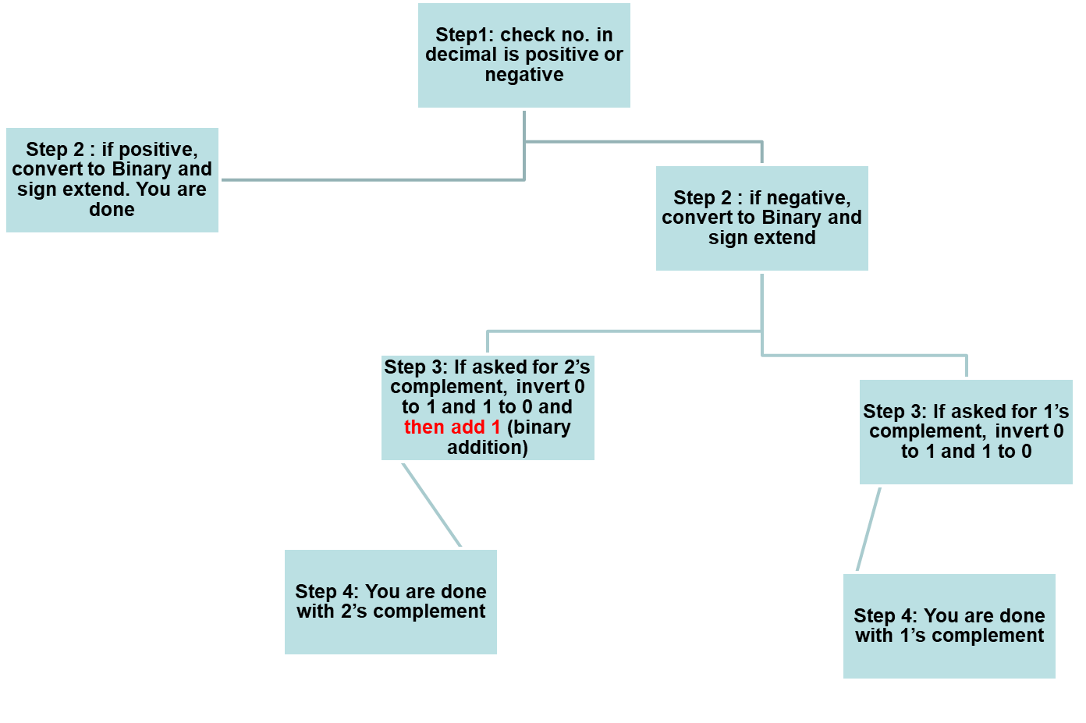
Summary of what we learnt so far

Slide 22
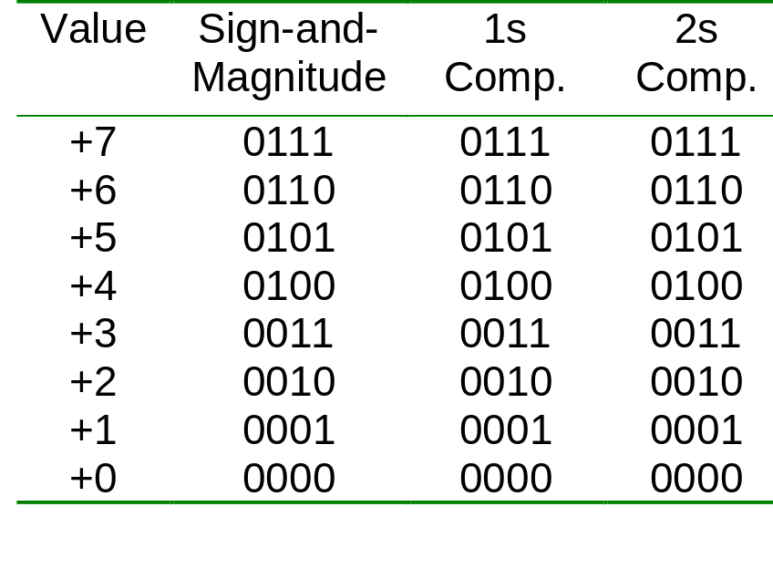
Comparisons of Sign-and-Magnitude and Complements
Example: 4-bit signed number (positive values)
Note: Signed magnitude cannot be used for arithmetic calculations

Slide 23
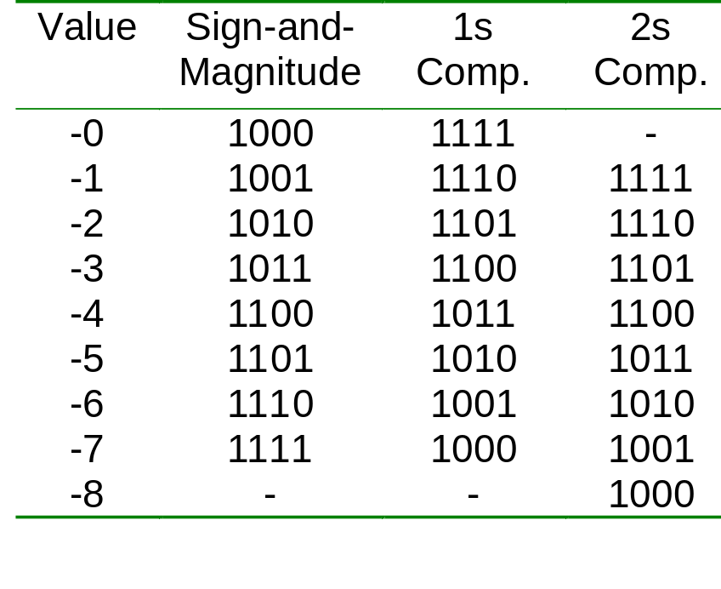
Comparisons of Sign-and-Magnitude and Complements
Example: 4-bit signed number (negative values)
Note: Signed magnitude cannot be used for arithmetic calculations

Slide 24
Exercise:
1. For 2’s complement binary numbers, the range of values for 5-bit numbers is
a. 0 to 31 b. -8 to +7 c. -8 to +8
d. -15 to +15 e. -16 to +15
2. In a 6-bit 2’s complement binary number system, what is the decimal value represented by (100100)_{2s}?
a. -4 b. 36 c. -36 d. -27 e. -28

Slide 25
Practice Time
1) Following numbers are in 1’s complement system. Turn them to their no. negative representation
1010101
0111000
0000001
00000
2) Now perform 2’s complement

Slide 26
Answer
1’s complement
2’s complement
A. Already negative
B. 1000111
C. 1111110
D.11111
Already negative
1001000
1111111
00000

Slide 27
Comparison between 1’s and 2’s complement
1’s complement
2’s complement
Easier to implement (convert between 0s and 1s)
2 representation of 0 (0000,1111)
1’s complement is mostly used in non-arithmetic applications
Easier substraction (no need of adding 1 in the case of carry)
2’s complement is mostly used in arithmetic applications

Slide 28
UNSIGNED NO. ARTHEMATIC OPERATION!

Slide 29
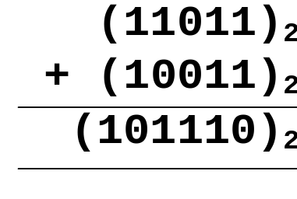
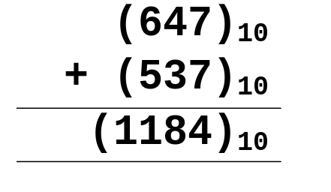
Binary Arithmetic Operations for Unsigned numbers
ADDITION
Like decimal numbers, two numbers can be added by adding each pair of digits together with carry propagation.

Slide 30
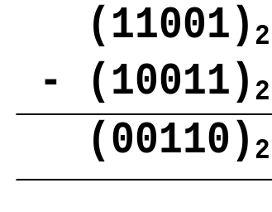
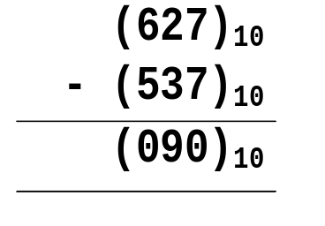
Binary Arithmetic Operations for Unsigned Numbers
SUBTRACTION
Two numbers can be subtracted by subtracting each pair of digits together with borrowing, where needed.

Slide 31
Overflow!

Slide 32
Unsigned numbers overflow
Carry-out can be used to detect overflow
The largest number that we can represent with 4-bits using unsigned numbers is 15
Suppose that we are adding 4-bit numbers: 9 (1001) and 10 (1010).
The value 19 cannot be represented with 4-bits
When operating with unsigned numbers, a carry-out of 1 can be used to indicate overflow
1 0 0 1 (9)
+ 1 0 1 0 (10)
1 0 0 1 1 (19)
Subtraction (lvk)

Slide 33
!!Overflow in Signed Number!!
With two’s complement and a 4-bit adder, for example, the largest representable decimal number is +7, and the smallest is -8.
What if you try to compute 4 + 5, or (-4) + (-5)?
We cannot just include the carry out to produce a five-digit result, as for unsigned addition. If we did, (-4) + (-5) would result in +7!
Also, unlike the case with unsigned numbers, the carry out cannot be used to detect overflow.
  In the example above, the carry out is 0 but there is overflow.
  Conversely, there are situations where the carry out is 1 but there is no overflow.
0 1 0 0 (+4)
+ 0 1 0 1 (+5)
0 1 0 0 1 (-7)
1 1 0 0 (-4)
+ 1 0 1 1 (-5)
1 0 1 1 1 (+7)
Subtraction (lvk)

Slide 34
Detecting signed overflow
The easiest way to detect signed overflow is to look at all the sign bits.
Overflow occurs only in the two situations above:
  If you add two positive numbers and get a negative result.
  If you add two negative numbers and get a positive result.
  ( Another way of detecting overflow is Carry in of MSB ≠ Carry out of MSB)
Overflow cannot occur if you add a positive number to a negative number. Do you see why?
0 1 0 0 (+4)
+ 0 1 0 1 (+5)
0 1 0 0 1 (-7)
1 1 0 0 (-4)
+ 1 0 1 1 (-5)
1 0 1 1 1 (+7)

Slide 35
Problem in signed arithmetic operation: Overflow
Signed binary numbers are of a fixed range.
If the result of addition/subtraction goes beyond this range, overflow occurs.
In case of unsigned no, if there is a carry out in MSB, then overflow has occurred.
In signed number, two conditions under which overflow can occur are:
(i) positive add positive gives negative
(ii) negative add negative gives positive
OR
Carry in of MSB ≠ Carry out of MSB

Slide 36
Overflow in Signed Number
Examples: 4-bit numbers (in 2s complement)
Range : (1000)_{2s} to (0111)_{2s} or (-8₁₀ to 7₁₀)
(i) (0101)_{2s} + (0110)_{2s}= (1011)_{2s}
(5)₁₀ + (6)₁₀= -(5)₁₀ ?! (overflow!)
(ii) (1001)_{2s} + (1101)_{2s} = (10110)_{2s} discard end-carry
= (0110)_{2s}
(-7)₁₀ + (-3)₁₀ = (6)₁₀ ?! (overflow!)

Slide 37
More examples on overflow:
Link: http://sandbox.mc.edu/~bennet/cs110/tc/add.html

Slide 38
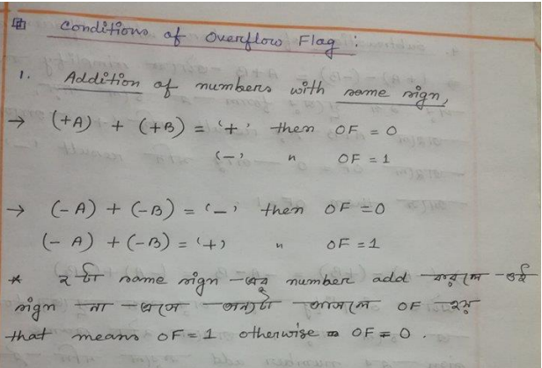
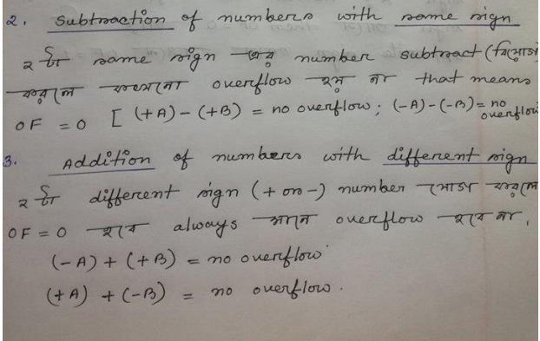

Slide 39
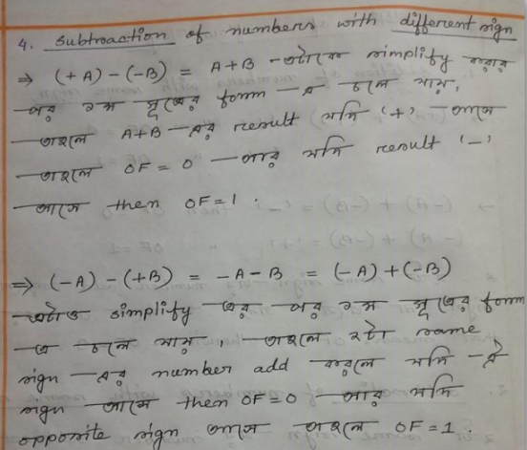

Slide 40
ARITHMETIC OPERATIONS ON SIGNED NUMBER

Slide 41
2s Complement Addition/Subtraction
Algorithm for addition, A + B:
Perform binary addition on the two numbers.
Ignore the carry out of the MSB (most significant bit).
Check for overflow: Overflow occurs if the ‘carry in’ and ‘carry out’ of the MSB are different, or if result is opposite sign of A and B.
Algorithm for subtraction, A – B:
A – B = A + (–B)
Take 2s complement of B by inverting all the bits and adding 1.
Add the 2s complement of B to A.

Slide 42
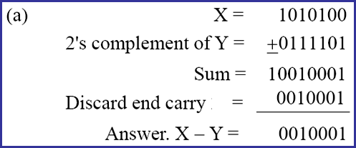
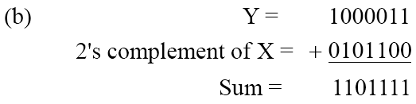
2s Complements Example
Given the two binary numbers X = 1010100 and Y = 1000011, perform the subtraction (a) X – Y and (b) Y − X by using 2's complement.

Slide 43
2s Complement Addition/Subtraction
Examples: 4-bit binary system
Which of the above is/are overflow(s)?
+3 0011
+ +4 + 0100
---- -------
+7 0111
---- -------
-2 1110
+ -6 + 1010
---- -------
-8 11000
---- -------
+6 0110
+ -3 + 1101
---- -------
+3 10011
---- -------
+4 0100
+ -7 + 1001
---- -------
-3 1101
---- -------

Slide 44
2s Complement Addition/Subtraction
More examples: 4-bit binary system
Which of the above is/are overflow(s)?
-3 1101
+ -6 + 1010
---- -------
-9 10111
---- -------
+5 0101
+ +6 + 0110
---- -------
+11 1011
---- -------

Slide 45
1s Complement Addition/Subtraction
Algorithm for addition, A + B:
Perform binary addition on the two numbers.
If there is a carry out of the MSB, add 1 to the result.
Check for overflow: Overflow occurs if result is opposite sign of A and B.
Algorithm for subtraction, A – B:
A – B = A + (–B)
Take 1s complement of B by inverting all the bits.
Add the 1s complement of B to A.

Slide 46
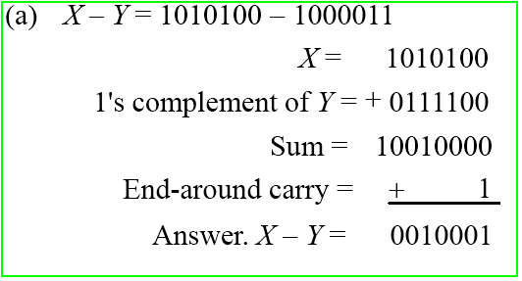
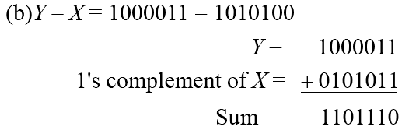
1s Complements Example
Repeat Previous Example, but this time using 1's complement.

Slide 47
1s Complement Addition/Subtraction
Examples: 4-bit binary system
+3 0011
+ +4 + 0100
---- -------
+7 0111
---- -------
+5 0101
+ -5 + 1010
---- -------
-0 1111
---- -------
-2 1101
+ -5 + 1010
---- ------
-7 10111
---- + 1
------
1000
-3 1100
+ -7 + 1000
---- -------
-10 10100
---- + 1
-------
0101

Slide 48
Exercise:
In a 4-bit twos-complement scheme, what is the result of this operation: (1011)_{2s} + (1001)_{2s}?
a. 0100 b. 0010 c. 1100 d. 1001 e. overflow
2. Assuming a 6-bit system, perform subtraction with the following unsigned binary numbers by taking first the 1's complement, and then, the 2's complement, of the second value and adding it with the first value:
(a) 011010 – 010000 (26 – 16)
(b) 011010 – 001101 (26 – 13)
(c) 000011 – 010000 (3 – 16)

Slide 49
Sign extension
In everyday life, decimal numbers are assumed to have an infinite number of 0s in front of them. This helps in “lining up” numbers.
To subtract 231 and 3, for instance, you can imagine:
231
- 003
228
You need to be careful in extending signed binary numbers, because the leftmost bit is the sign and not part of the magnitude.
If you just add 0s in front, you might accidentally change a negative number into a positive one!
For example, going from 4-bit to 8-bit numbers:
  0101 (+5) should become 0000 0101 (+5).
  But 1100 (-4) should become 1111 1100 (-4).
The proper way to extend a signed binary number is to replicate the sign bit, so the sign is preserved.
Subtraction (lvk)

Slide 50
Practice Problem
1-12, 1-15
(Morris Mano Chapter 1)
A-10
B-11
C-12
D-13
E-14
F-15

